Slide 1


COMPUTER NETWORKS
UNIT-2
Computer Networks
Unit-2

Slide 2
CONTENTS
Data Link Layer: Design issues
Framing
Error detection and correction
Elementary data link protocols: simplex protocol, A Simplex Stop and Wait Protocol for an Error-free channel, A Simplex Stop and Wait Protocol for Noisy Channel
Sliding Window protocols: A One-Bit Sliding Window Protocol, A protocol using Go-Back-N, A Protocol using Selective Repeat
Example data link protocols
Medium Access Sub Layer: The Channel allocation problem,
Multiple Access Protocols: ALOHA, Carrier Sense Multiple Access Protocols, Collision Free Protocols
Ethernet.
Computer Networks
Unit-2

Slide 3
INTRODUCTION
Previous Layer: The Physical Layer
The physical layer is concerned with transmitting raw bits over a communication
channel.
Next Layer: The Data Link Layer
The main task of the data link layer is to transform a raw transmission facility into a line that appears free of undetected transmission errors to the network layer.
Why Data Link Layer?
You might think this problem is so trivial that there is no software to study – machine A just puts the bits on the wire, and machine B just takes them off.
Unfortunately, communication circuits make errors occasionally.
Computer Networks
Unit-2

Slide 4
INTRODUCTION
Machines have only a finite data rate, and there is a nonzero propagation delay between the time a bit is sent and the time it is received.
These limitations have important implications for the efficiency of the data
transfer.
The protocols used for communication must take all these factors into consideration.
Computer Networks
Unit-2

Slide 5
DATA LINK LAYER DESIGN ISSUES
The data link layer’s specific functions:
  Providing a well-defined service interface to the network layer
  Dealing with transmission errors
  Regulating the flow of data so that slow receivers are not swamped by fast senders.
  The data link layer takes the packets it gets from the network layer and encapsulates them into the frames for transmission.
  Each frame consists of a frame header, a payload field for holding the packet, and a frame trailer.
  Frame management forms the heart of what the data link layer does.
Computer Networks
Unit-2

Slide 6
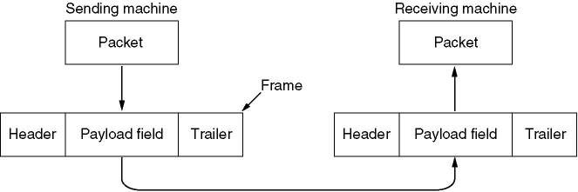
DATA LINK LAYER DESIGN ISSUES
Relationship between packets and frames.
Computer Networks
Unit-2

Slide 7
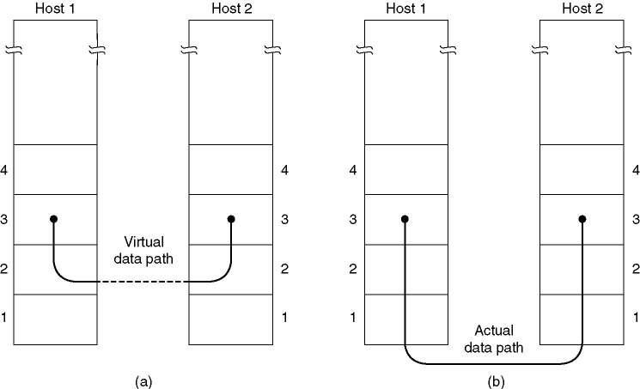
DATA LINK LAYER DESIGN ISSUES
Services Provided to Network Layer:
The principal service is transferring data from the network layer on the source machine to the network layer on the destination machine.
The job of the data link layer is to transmit the bits to the destination machine so they can be handed over to the network layer.
(a) Virtual communication. (b) Actual communication.
Computer Networks
Unit-2

Slide 8
DATA LINK LAYER DESIGN ISSUES
Services Provided to Network Layer:
The data link layer can be designed to offer various services.
  Unacknowledged connectionless service.
  Acknowledged connectionless service.
  Acknowledged connection-oriented service.
Computer Networks
Unit-2

Slide 9
DATA LINK LAYER DESIGN ISSUES
Services Provided to Network Layer: Unacknowledged connectionless service:
The source machine sends independent
frames to the destination machines
without having the destination machine acknowledge them.
No logical connection is established beforehand or released afterward.
If a frame is lost due to noise on the line, no attempt is made to detect the loss or recover from it in the data link layer.
It is used where error rate is very low, for real-time traffic such as voice, most LANs use it.
Computer Networks
Unit-2

Slide 10
DATA LINK LAYER DESIGN ISSUES
Services Provided to Network Layer:
Acknowledged connectionless service:
Reliable connectionless service
When this service is offered, there are still no logical connections used, but each frame sent is individually acknowledged.
In this way, the sender knows whether a frame has arrived correctly.
If it has not arrived within a specified time interval, it can be sent again.
For unreliable channels, such as wireless systems.
Computer Networks
Unit-2

Slide 11
DATA LINK LAYER DESIGN ISSUES
Services Provided to Network Layer: Acknowledged connection-oriented service:
The source and destination machines establish
a connection before and data are
transferred.
Each frame sent over the connection is numbered, and the data link layer guarantees that each frame sent is indeed received.
Furthermore, it guarantees that each frame is received exactly once and that all frames are
received in the right order.
There are three distinct phases in connection oriented service.
  The connection is established;
  Frames are transmitted by this connection;
  The connection is released.
Computer Networks
Unit-2

Slide 12
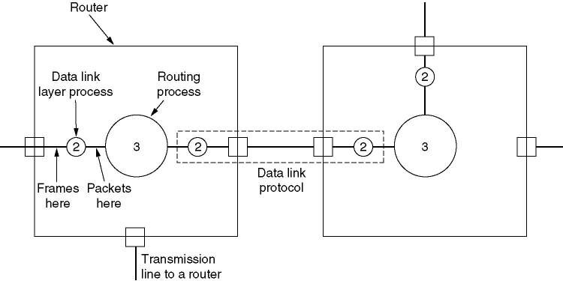
DATA LINK LAYER DESIGN ISSUES
Example: A WAN subnet consisting of routers connected by point-topoint leased telephone lines..
Placement of the data link protocol.
Computer Networks
Unit-2

Slide 13
DATA LINK LAYER DESIGN ISSUES: FRAMING
To provide service to the network layer, the data link layer must use the service provided to it by the physical layer.
What the physical layer does is accept a row bit stream and attempt to deliver it to the destination.
The number of bits received may be less than, equal to, or more than the number of bits transmitted, an they may have different values.
It is up to the data link layer to detect and, if necessary, correct errors.
The usual approach is for the data link layer to break the bit stream up into discrete frames and compute the checksum for each frame.
When a frame arrives at the destination, the checksum is recomputed.
If the newly – computed checksum is different from the one contained in the frame, the data link layer knows that an error has occurred and takes steps to deal with it.
Computer Networks
Unit-2

Slide 14
DATA LINK LAYER DESIGN ISSUES: FRAMING
The methods to break the bit stream up into frames:
  Character count
  Flag bytes with byte stuffing
  Starting and ending flags, with bit stuffing
  Physical layer coding violations
Computer Networks
Unit-2

Slide 15
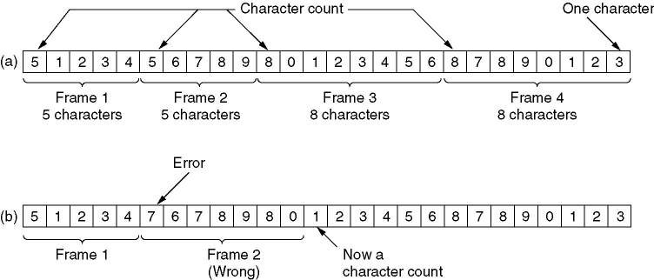
DATA LINK LAYER DESIGN ISSUES: FRAMING
Character count:
This framing method uses a field in the header to specify the number of characters in the frame.
When the data link layer at the destination sees the character count, it knows how many characters follow and hence where the end of the frame is.
The trouble with this algorithm is that the count can be garbled by a transmission error.
A character stream. (a) Without errors for four frames of sizes 5, 5,8, and 8 characters, respectively. (b) With one error.
Computer Networks
Unit-2

Slide 16
DATA LINK LAYER DESIGN ISSUES: FRAMING
Flag bytes with byte stuffing:
This method gets around the problem of resynchronization after an error by having each frame start and end with special bytes.
The starting and ending Flag Bytes are same in recent years.
If the receiver ever loses synchronization, it can just search for the flag byte to find the end of the current frame.
2 consecutive flag bytes indicate the end of one frame and start of next one.
Computer Networks
Unit-2

Slide 17
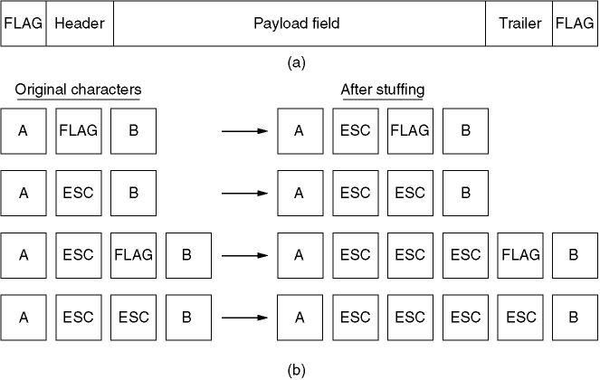
DATA LINK LAYER DESIGN ISSUES: FRAMING
Flag bytes with byte stuffing:
A frame delimited by flag bytes.
Four examples of byte sequences before and after stuffing.
Computer Networks
Unit-2

Slide 18
DATA LINK LAYER DESIGN ISSUES: FRAMING
Flag bytes with byte stuffing:
A serious problem occurs with this method when binary data, such as object programs or floating point numbers, are being transmitted.
It may easily happen that the flag byte’s bit pattern occurs in the data.
This situation will usually interfere with the framing.
One way to solve this problem is to have the sender’s data link layer insert a special escape byte (ESC) just before each “accidental” flag byte in the data.
A major disadvantage of using this framing method is that it is closely tied to the use of 8-
bit characters.
Not all character code use 8-bit characters.
For example, UNICODE uses 16-bit characters.
As networks developed, the disadvantages of embedding the character code length in the
framing mechanism became more and more obvious, so a new technique had to be developed to allow arbitrary sized characters.
Computer Networks
Unit-2

Slide 19
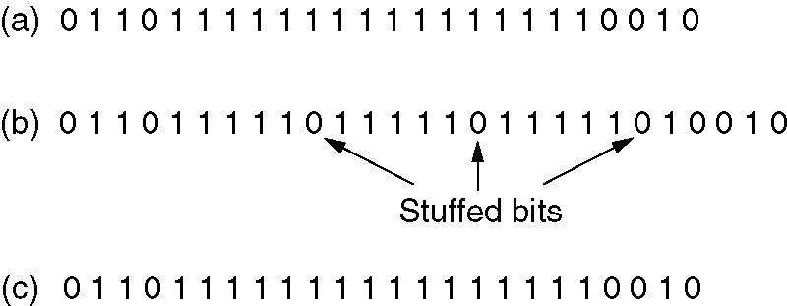
DATA LINK LAYER DESIGN ISSUES: FRAMING
Starting and ending flags, with bit stuffing:
The new technique allows data frames to contain an arbitrary number of bits and allows character codes with an arbitrary number of bits per character.
Each frame begins and ends with a special bit pattern, 0111110 (in fact, a flag byte).
Whenever the sender’s data link layer encounters five consecutive 1s in the data, it automatically stuffs a 0 bit into the outgoing bit stream.
Bit stuffing
The original data.
The data as they appear on the line.
The data as they are stored in receiver’s memory after destuffing.
Computer Networks
Unit-2

Slide 20
DATA LINK LAYER DESIGN ISSUES: FRAMING
Physical layer coding violations:
This method is only applicable to networks in which the encoding on the physical medium contains some redundancy.
For example, some LANs encode 1 bit of data by using 2 physical bits.
Normally, a 1 bit is a high-low pair and a 0 bit is a low-high pair.
11 or 00 are not used for data but are used for delimiting frames in some protocols.
Computer Networks
Unit-2

Slide 21
DATA LINK LAYER DESIGN ISSUES: ERROR CONTROL
The usual way to ensure reliable delivery is to provide the sender with some feedback about what is happening at the other end of the line.
Typically, the protocol calls for the receiver to send back special control frames.
If the sender receives a positive acknowledgement about a frame, it knows the frame has arrived safely.
On the other hand, a negative acknowledgement means that something has gone wrong,
and the frame must be transmitted again.
Computer Networks
Unit-2

Slide 22
DATA LINK LAYER DESIGN ISSUES: FLOW CONTROL
Another important design issue that occurs in the data link layer (and higher layers as well) is what to do with a sender that systematically wants to transmit frames faster than the receiver can accept them.
To solve this problem feedback-based flow control and rate-based flow control are used.
Feedback-based flow control: the receiver sends back information to the sender giving it permission to send more data or at least telling the sender how the receiver is doing.
Rate-based flow control: the protocol has a built-in mechanism that limits the rate at
which senders may transmit data, without using feedback from the receiver.
Rate-based flow control is never used in the data link layer.
Computer Networks
Unit-2

Slide 23
ERROR DETECTION AND CORRECTION
The telephone system has three parts:
  the switches – almost entirely digital
  the interoffice trunks - almost entirely digital
  the local loops – still analog (twisted copper pairs)
While errors are rare on the digital part, they are still common on the local loops.
Furthermore, wireless communication is becoming more common, and the error rates
here are orders of magnitude worse than on the interoffice fiber trunks.
The conclusion is: transmission errors are going to be with us for many years to come.
Computer Networks
Unit-2

Slide 24
ERROR DETECTION AND CORRECTION
As a result of the physical processes that generate them, errors on some media (e.g., radio) tend to come in bursts rather than singly.
The advantage of bursts errors is that the computer data are always sent in blocks of bits.
The disadvantage is that they are much harder to correct than are isolated errors.
Error-Correcting Codes
  To include enough redundant information along with each block of data sent, to enable the receiver to deduce what the transmitted data must have been.
Error-Detecting Codes
  To include only enough redundancy to allow the receiver to deduce that an error occurred, but not which error, and have it request a retransmission.
On channels that are highly reliable, such as fiber, it is cheaper to use an error detecting
code and just retransmit the occasional block found to be faulty.
On channels such as wireless links that make many errors, it is better to add enough redundancy to each block for the receiver to be able to figure out what the original block was, rather than relying on a retransmission, which itself may be in error.
Computer Networks
Unit-2

Slide 25
ERROR DETECTION AND CORRECTION
Error Correcting Codes:
What is an error?
Normally, a frame consists of m data bits and r redundant, or check, bits.
The total length is n (n=m+r)
An n-bit unit containing data and check bits is often referred to as an n-bit codeword.
Given any two codeword (say, 10001001 and 10110001), it is possible to determine how many corresponding bits differ. As we see in this case 3 bits differ.
To determine how many bits differ, just exclusive OR the two codewords and count the number of 1 bits in the result, for example:
10001001
10110001
--------------
00111000
Computer Networks
Unit-2

Slide 26
ERROR DETECTION AND CORRECTION
Error Correcting Codes:
The number of bit positions in which two codewords differ is called the Hamming distance.
Its significance is that if two codewords are a Hamming distance d apart, it will require d single bit errors to convert one into the other.
2^{m} possible data message are legal;
But due to the way the check bits are computed, not all of the 2^{n} possible codewords are used.
It is possible to construct a complete list of legal codewords by given algorithm for computing the check bits, and from this find the two codewords whose Hamming distance is minimum.
This distance is the Hamming distance of the complete code.
The error-detecting and error –correcting properties of a code depend on its Hamming distance.
To detect d errors, you need a distance d+1 code because with such a code there is no way that d single-bit errors can change a valid codeword.
When the receiver sees an invalid codeword, it can tell that a transmission error has occurred.
Computer Networks
Unit-2

Slide 27
ERROR DETECTION AND CORRECTION
Error Correcting Codes:
Similarly, to correct d errors, you need a distance 2d+1 code because that way the legal codewords are so far apart that even with d changes, the original codeword is still closer than any other codeword, so it can be uniquely determined.
As a simple example of an error-detecting code, consider a code in which a single parity bit is appended to the data.
The parity bit is chosen so that the number of 1 bits in the codeword is even (or odd).
For example, when 1011010 is sent in even parity, a bit is added to the end to make it 10110100.
With odd parity 1011010 becomes 10110101.
A code with a single parity bit has a distance 2, since any single-bit error produces a codeword with the wrong parity.
It can be used to detect single errors.
Computer Networks
Unit-2

Slide 28
ERROR DETECTION AND CORRECTION
Error Correcting Codes:
Example:
Consider a code with only four valid codewords: 0000000000, 0000011111, 1111100000, 1111111111
This code has a distance 5, which means that it can correct double errors, because of 5=2d+1.
If codeword 0000000111 arrives, the receiver knows, that the original must have been 0000011111.
If however a triple error changes 0000000000 into 0000000111, the error will not be corrected
properly.
Imaging that we want to design a code with m message bits and r check bits that will allow all single errors to be corrected.
Each of the 2^{m} legal message has n illegal codewords at a distance 1 from it.
These are formed by systematically inverting each of the n bits in the n-bit codeword formed
from it.
Thus each of 2^{m} legal messages requires n+1 bit patterns dedicated to it.
Computer Networks
Unit-2

Slide 29
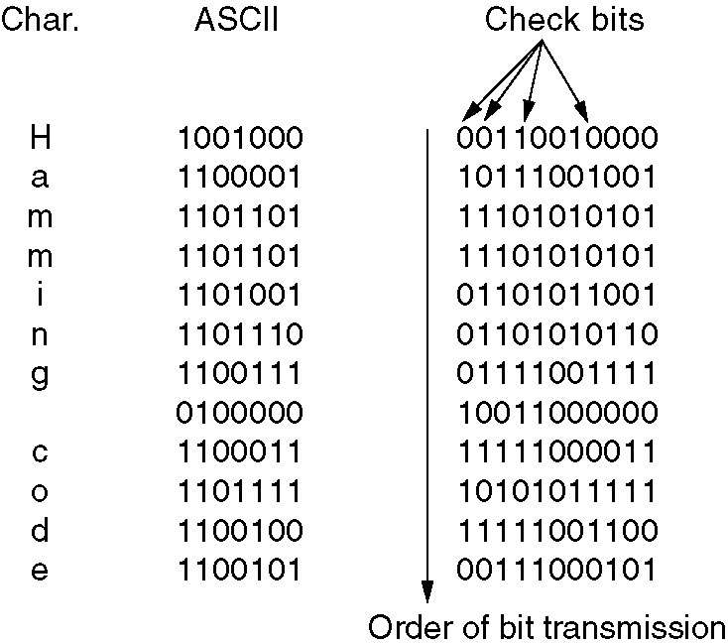
ERROR DETECTION AND CORRECTION
Error Correcting Codes:
Example:
Since the total number of bit patterns is 2^{n}, we must have (n+1)2^{m} ≤ 2^{n}.
Using n=m+r, this requirement becomes (m+r+1) ≤2^{r}.
Given m, this puts a lower limit on the number of check bits needed to correct single errors.
Use of a Hamming code to correct burst errors.
Computer Networks
Unit-2

Slide 30
ERROR DETECTION AND CORRECTION
Error Detecting Codes:
Error correcting codes are widely used on wireless links, which are noisy and error prone when compared to copper wire or optical fibers.
Without error correcting codes, it would be hard to get anything through.
However over copper wire or fiber, the error rate is much lower, so error detection and retransmission is usually more efficient there for dealing with the occasional error.
Example:
Consider a channel on which errors are isolated and the error rate is 10⁻⁶ per bit.
Let the block size be 1000 bits.
To provide error correction for 1000-bit block, 10 check bits are needed: a megabit of data would require 10,000 check bits.
To merely detect a block with a single 1-bit error, one parity bit per block will suffice.
Once every 1000 blocks, an extra block (1001 bits) will have to be transmitted.
The total overhead for the error detection + retransmission method is only 2001 bits per megabit of data, versus 10,000 bits for a Hamming code.
Computer Networks
Unit-2

Slide 31
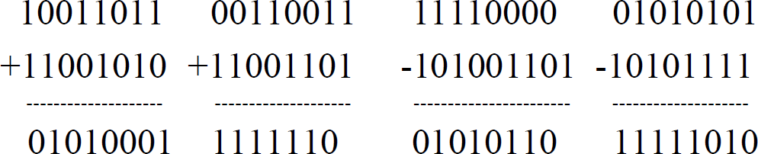
ERROR DETECTION AND CORRECTION
Error Detecting Codes:
The polynomial code or CRC (Cyclic Redundancy Check) is in widespread use;
Polynomial codes are based upon treating bit strings as representations of polynomials with coefficients of 0 and 1 only.
A k-bit frame is regarded as the coefficient list for a polynomial with k terms, ranging from x^{k-1} to x⁰.
Such a polynomial is said to be of degree k-1.
For example: 110001 is x⁵+x⁴+x⁰
Polynomial arithmetic is done modulo 2, according to the rules of algebraic field theory.
There are no carries for addition or borrows for subtraction.
Both addition and subtraction are identical to exclusive OR.
For example:
Computer Networks
Unit-2

Slide 32
ERROR DETECTION AND CORRECTION
Error Detecting Codes:
When the polynomial code method is employed, the sender and receiver must agree upon a generator polynomial, G(x), in advance.
Both high- and low- order bits of the generator must be 1.
To compute the checksum for some frame with m bits, corresponding to the polynomial M(x), the frame must be longer than the generator polynomial.
The idea is to append a checksum to the end of the frame in such a way that the polynomial represented by the checksummed frame is divisible by G(x).
When the receiver gets the checksummed frame, it tries dividing it by G(x).
If there is a remainder, there has been a transmission error.
Computer Networks
Unit-2

Slide 33
ERROR DETECTION AND CORRECTION
Error Detecting Codes:
The algorithm for computing the checksum is as follows:
  Let r be the degree of G(x). Append r zero bits to the loworder end of the frame so it now
contains m+r bits and corresponds to the polynomial x^{r}M(x).
  Divide the bit string corresponding to G(x) into the bit string corresponding to x^{r}M(x), using modulo 2 division.
  Subtract the remainder (which is always r or fewer bits) from the bit string corresponding to x^{r}M(x) using modulo 2 subtraction. The result is the checksummed frame to be transmitted. Call its polynomial T(x).
Computer Networks
Unit-2

Slide 34
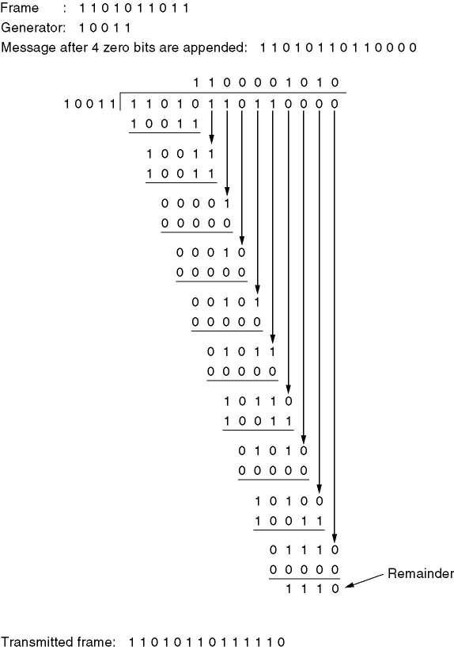
ERROR DETECTION AND CORRECTION
Error Detecting Codes:
This example illustrates the calculation for a frame M(t)= 1101011011 using the generator G(x)=x4+x+1. r=4
x^{r}M(x)=11010110110000 T(x)=11010110111110
E(x) is error polynomial
Calculation of the polynomial code checksum.
Computer Networks
Unit-2

Slide 35
ERROR DETECTION AND CORRECTION
Error Detecting Codes:
What kinds of errors will be detected?
Imaging that a transmission error occurs, so that instead of the bit string for T(x) arriving,
T(x)+E(x) arrives.
Each 1 bit in E(x) corresponds to a bit that has been inverted.
If there are k 1 bits in E(x), k single-bit errors have occurred.
A single burst error is characterized by an initial 1, a mixture of 0s and 1s, and a final 1, with all other bits being 0.
Upon receiving the checksummed frame, the receiver divides it by G(x); that is, it computes [T(x)+E(x)]/G(x).
T(x)/G(x) is 0, so the result of the computation is simply E(x)/G(x).
Those errors that happen to correspond to polynomials containing G(x) as a factor will slip by; all other errors will be caught.
Computer Networks
Unit-2

Slide 36
ELEMENTARY DATA LINK PROTOCOLS
Three protocols of increasing complexity:
A simulator for protocols is available via Web http://www.prenhall.com/tanenbaum
ASSUMPTION 1:
In the physical layer (PhL), data link layer (DLL), and network layer (NL) are independent processes that communicate by passing messages back and forth.
In many cases, PhL and DLL processes will be running on a processor inside a special network I/O chip and NL code will be running on the main CPU.
However, other implementations are also possible:
three processes inside a single I/O chip;
or PhL and DLL as procedures called by NL process.
In any event, treating the three layers as separate processes makes the discussion conceptually cleaner and also serves to emphasize the independence of the layers.
Computer Networks
Unit-2

Slide 37
ELEMENTARY DATA LINK PROTOCOLS
ASSUMPTION 2:
Machine A wants to send a long stream of data to machine B, using reliable, connection-oriented service.
Later, we will consider the case where B also wants to send data to A simultaneously.
A is assumed to have an infinite supply of data ready to send and never has to wait for data to be produced.
Instead, when A’s DLL asks for data, NL is always able to comply immediately. This restriction will be dropped later.
Computer Networks
Unit-2

Slide 38
ELEMENTARY DATA LINK PROTOCOLS
ASSUMPTION 3:
Machines do not crash. That is these protocols deal with communication errors, but not the problems caused by computers crashing and rebooting.
The packet passed across the interface to DLL from NL is pure data, whose every bit is to be delivered to the destination’s NL.
The fact that the destination’s NL may interpret part of the packet as a header is of no concern to DLL.
Computer Networks
Unit-2

Slide 39
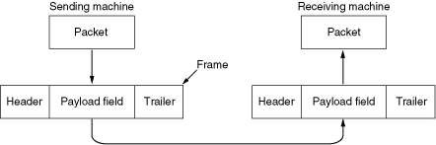
ELEMENTARY DATA LINK PROTOCOLS
ASSUMPTION 3:
When DLL accepts a packet, it encapsulates the packet in a frame by adding a data link header and trailer to it.
Thus, a frame consists of an embedded packet, some control information (in the header), and a
checksum (in the trailer).
The frame is then transmitted to DLL on the other machine.
Computer Networks
Unit-2

Slide 40
ELEMENTARY DATA LINK PROTOCOLS
Library procedures:
to_physical_layer is for sending a frame
from_physical_layer is for receiving a frame
The transmitting hardware computes and appends the checksum (thus creating the trailer), so that DLL software need not worry about it.
The polynomial algorithm discussed earlier in this chapter might be used, for example.
Initially, the receiver just sits around waiting for something to happen (e.g., a frame has arrived).
wait_for_event(&event) is for receiver to act
Variable event tells what happened.
For example, event=cksum_err means that the checksum is incorrect, there was a transmission error.
event=frame_arrival means the inbound frame arrived undamaged.
The set of possible events differs for the various protocols.
Computer Networks
Unit-2

Slide 41
ELEMENTARY DATA LINK PROTOCOLS
Library procedures:
Following slide shows some declarations (in C) common to many of protocols to be discussed later.
Five data structures are defined there:
  boolean – is an enumerated type and can take on the values true and false.
  seq_nr is a small integer (0 - MAX_SEQ ) used to number the frames so that we can tell them apart.
  packet is the unit of information exchanged between NL and DLL on the same machine, or between NL peers. In our model packet contains MAX_PKT bytes, but may be of variable length.
  frame_kind is wether there are any data in frame, because some of protocols distinguish frames containing only control information from those containing data as well.
Computer Networks
Unit-2

Slide 42
ELEMENTARY DATA LINK PROTOCOLS
Library procedures:
frame is composed of four fields: kind, seq, ack, and info. The first three contain control information. These control fields are collectively called the frame header. A last one may contain actual data to be transferred.
  kind – whether there are any data in the frame.
  seq – for sequence numbers
  ack – for acknowledgements
  info – in data frame it contains a single packet A number of procedures are also listed in figure.
Computer Networks
Unit-2

Slide 43
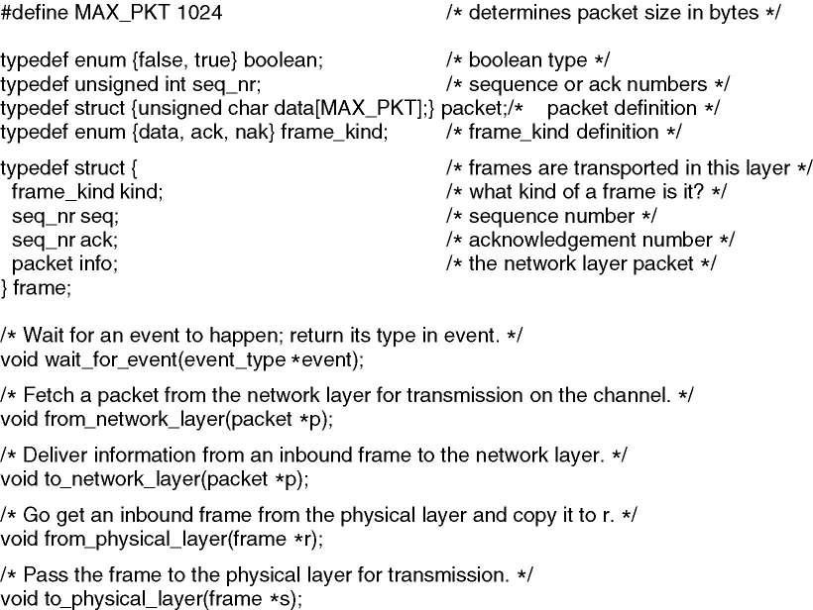
ELEMENTARY DATA LINK PROTOCOLS
Library procedures:
Some definitions needed in the protocols to follow.
These are located in the file protocol.h.
Computer Networks
Unit-2

Slide 44
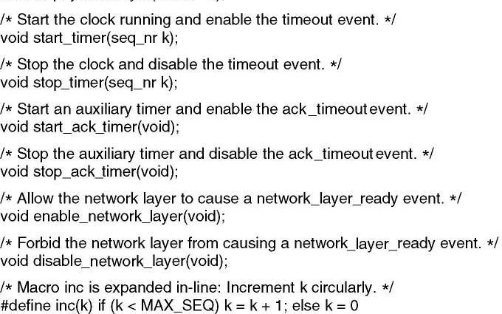
ELEMENTARY DATA LINK PROTOCOLS
Library procedures:
Some definitions needed in the protocols to follow.
These are located in the file protocol.h.
Computer Networks
Unit-2

Slide 45
ELEMENTARY DATA LINK PROTOCOLS
Library procedures:
In most of the protocols, we assume that the channel is unreliable and loses entire frames upon occasion.
To be able to recover from such calamities, the sending DLL must start an internal or clock whenever it sends a frame.
If no reply has been received within a certain predetermined time interval, the clock times out and DLL receives an interrupt signal.
In our protocols this is handled by allowing the procedure wait_for_event to return event=timeout.
The procedures start_timer and stop_timer turn the timer on and off, respectively.
The procedures start_ack_timer and stop_ack_timer control an auxiliary timer used to generate acknowledgements under certain conditions.
Computer Networks
Unit-2

Slide 46
ELEMENTARY DATA LINK PROTOCOLS
PROTOCOL 1: An Unrestricted Simplex Protocol
PROTOCOL 2: A Simplex Stop-and-Wait Protocol
PROTOCOL 3: A Simplex Protocol for a Noisy Channel
Computer Networks
Unit-2

Slide 47
ELEMENTARY DATA LINK PROTOCOLS
PROTOCOL 1: An Unrestricted Simplex Protocol
Data are transmitted in one direction only.
Both the transmitting and receiving network layers are always ready.
Processing time can be ignored.
Infinite buffer space is available.
The communication channel between the data link layers never damages or loses frames.
This is thoroughly unrealistic protocol and we nickname it as “utopia”.
Computer Networks
Unit-2

Slide 48
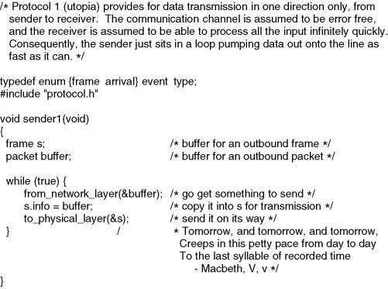
ELEMENTARY DATA LINK PROTOCOLS
PROTOCOL 1: An Unrestricted Simplex Protocol
Computer Networks
Unit-2

Slide 49
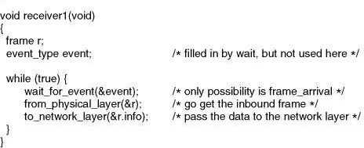
ELEMENTARY DATA LINK PROTOCOLS
PROTOCOL 1: An Unrestricted Simplex Protocol
Computer Networks
Unit-2

Slide 50
ELEMENTARY DATA LINK PROTOCOLS
PROTOCOL 2: Simplex Stop-and-Wait Protocol
Now we will drop the most unrealistic restriction used in Protocol 1: the ability of the receiving NL to process incoming data infinitely quickly.
The communication channel is still assumed to be error free however, and the data traffic is still simplex.
The main problem we have to deal with here is how to prevent the sender from flooding the
receiver with data faster than the latter is able to process them.
Computer Networks
Unit-2

Slide 51
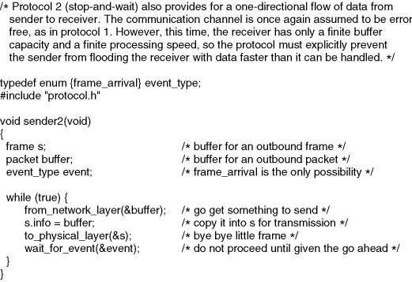
ELEMENTARY DATA LINK PROTOCOLS
PROTOCOL 2: Simplex Stop-and-Wait Protocol
Computer Networks
Unit-2

Slide 52
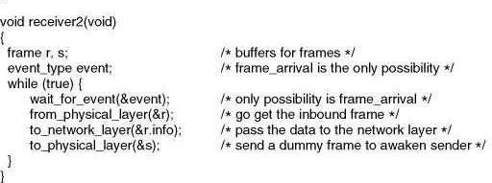
ELEMENTARY DATA LINK PROTOCOLS
PROTOCOL 2: Simplex Stop-and-Wait Protocol
Computer Networks
Unit-2

Slide 53
ELEMENTARY DATA LINK PROTOCOLS
PROTOCOL 2: Simplex Stop-and-Wait Protocol
If the receiver requires a time Δt to execute from_physical_layer plus to_network_layer, the sender must transmit at an average rate less than one frame per time Δt.
If we assume that no automatic buffering and queuing are done within the receiver’s hardware, the sender must never transmit a new frame until the old one has been fetched by from_physical_layer, let the new one overwrite the old one.
Protocols in which the sender sends one frame and then waits for an acknowledgement
before proceeding are called stop-and-wait.
Computer Networks
Unit-2

Slide 54
ELEMENTARY DATA LINK PROTOCOLS
PROTOCOL 3: A Simplex Protocol for a Noisy Channel
Frames may be either damaged or lost completely.
However, we assume that if a frame is damaged in transit, the receiver hardware will detect this when it computes the checksum.
If the frame is damaged in such a way that the checksum is nevertheless correct, an unlikely occurrence, this protocol (and all other protocols) can fail (i.e., deliver an incorrect packet to the network layer).
A simple solution is to change Protocol 1 by adding timer such a way:
The sender could send a frame, but the receiver would only send an acknowledgement frame if the data were correctly received.
If a damaged frame arrived at the receiver, it would be discarded.
After a while the sender would time out and send the frame again.
This process would be repeated until the frame finally arrived intact.
Computer Networks
Unit-2

Slide 55
ELEMENTARY DATA LINK PROTOCOLS
PROTOCOL 3: A Simplex Protocol for a Noisy Channel
The above scheme has a fatal flaw in it.
The task of DLL processes is to provide error-free, transparent communication between NL processes.
NL on machine A gives a series of packets to its DLL, which must ensure that an identical series of packets are delivered to NL on machine B by its DLL.
In particular, NL on B has no way of knowing that a packet has been lost or duplicated, so
DLL must guarantee that no combination of transmission errors, however unlikely, can cause a duplicate packet to be delivered to NL.
Computer Networks
Unit-2

Slide 56
ELEMENTARY DATA LINK PROTOCOLS
PROTOCOL 3: A Simplex Protocol for a Noisy Channel
Consider the following scenario:
NL on A gives packet 1 to its DLL. The packet is correctly received at B and passed to NL on B.
B sends an acknowledgement frame back to A.
The acknowledgement frame gets lost completely. It just never arrives at all. Not only data frames but also control frames may be lost.
DLL on A eventually times out. Not having received an acknowledgement, it (incorrectly)
assumes that its data frames was lost or damaged and sends the frame containing packet 1
again.
The duplicate frame also arrives at DLL on B perfectly and is unwittingly passed to NL there. If A is sending a file to B, part of the file will be duplicated (i.e., the copy of the file made by B will be incorrect and the error will not have been detected). In other words, the protocol will
fail.
One solution: By sequence number in the header of each frame the receiver can check if it is a new frame or a duplicate to be discarded.
Computer Networks
Unit-2

Slide 57
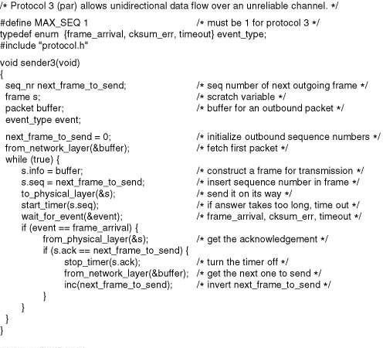
ELEMENTARY DATA LINK PROTOCOLS
PROTOCOL 3: A Simplex Protocol for a Noisy Channel
A positive acknowledgement with retransmission protocol.
Computer Networks
Unit-2
57

Slide 58
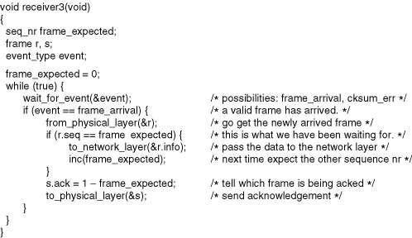
ELEMENTARY DATA LINK PROTOCOLS
PROTOCOL 3: A Simplex Protocol for a Noisy Channel
A positive acknowledgement with retransmission protocol.
Computer Networks
Unit-2
57

Slide 59
ELEMENTARY DATA LINK PROTOCOLS
PROTOCOL 3: A Simplex Protocol for a Noisy Channel
Protocols in which the sender waits for a positive acknowledgement before advancing to the next data item are often called PAR (Positive Acknowledgement with Retransmission) or ARQ (Automatic Repeat reQuest).
Like protocol 2, this one also transmits data only in one direction.
Protocol 3 differs from Protocol 2 in that both sender and receiver have a variable whose
value is remembered while DLL is in the wait state.
Computer Networks
Unit-2

Slide 60
SLIDING WINDOW PROTOCOLS
In the previous protocols, data frames were transmitted in one direction only.
In most practical situations, there is a need for transmitting data in both directions.
One way of achieving full-duplex data transmission is to have two separate communication channels and use each one for simplex data traffic (in different directions).
If this is done, we have two separate physical circuits, each with a “forward” channel (for data) and a “reverse” channel (for acknowledgements).
In both cases the bandwidth of the reverse channel is almost entirely wasted.
In effect, the user is paying for two circuits but using only the capacity of one.
Computer Networks
Unit-2

Slide 61
SLIDING WINDOW PROTOCOLS
Another way of achieving full-duplex data transmission is to use the same circuit for data in both directions.
In protocols 2 and 3 “forward” and “reverse” channels were used and both of them have the same capacity.
Now we will discuss the model in which the data frames from A to B are intermixed with the acknowledgement frames from A to B.
By looking at the kind field in the header of an incoming frame, the receiver can tell
whether the frame is data or acknowledgement.
Computer Networks
Unit-2

Slide 62
SLIDING WINDOW PROTOCOLS
Piggybacking:
Although interleaving data and control frames on the same circuit is an improvement over having two separate physical circuits, yet another improvement is possible.
When a data frame arrives, instead of immediately sending a separate control frame, the receiver restrains itself and waits until the network layer passes it the next packet.
The ACK is attached to the outgoing data frame (using the ACK field in the frame header).
In effect, ACK gets free ride on the next outgoing data frame.
The technique of temporarily delaying outgoing ACK so that they can be hooked onto the next outgoing data frame is known as Piggybacking.
Computer Networks
Unit-2

Slide 63
SLIDING WINDOW PROTOCOLS
Piggybacking:
The principal advantage of using piggybacking over having distinct ACK frames is a better use of the available channel bandwidth.
The ACK field in the frame header costs only a few bits, whereas a separate frame would
need a header, the ACK, and a checksum.
In addition, fewer frames sent means fewer “frame arrival” interrupts, and perhaps fewer buffers in the receiver, depending on how the receiver’s software is organized.
In the next protocol to be examined, the piggyback field costs only 1 bit in the frame header.
It rarely costs more than a few bits.
However, piggybacking introduces a complication not present with separate ACSs.
How long should the data link layer wait for a packet onto which to piggyback the acknowledgement?
Computer Networks
Unit-2

Slide 64
SLIDING WINDOW PROTOCOLS
Piggybacking:
If the data link layer waits longer than the sender’s timeout period, the frame will be retransmitted, defeating the whole purpose of having ACKs.
If the data link layer were an oracle and could foretell the future, it would know when the
next network layer packet was going to come in and could decide either to wait for it or send a separate ACK immediately, depending on how long the projected wait was going to be.
Of course, the data link layer cannot foretell the future, so it must resort to some ad hoc scheme, such as waiting a fixed number of milliseconds.
If a new packet arrives quickly, the ACK is piggybacked onto it; otherwise, if no packet has
arrived by the end of this time period, the data link layer just sends a separate ACK frame.
Computer Networks
Unit-2

Slide 65
SLIDING WINDOW PROTOCOLS
The next three protocols are bidirectional protocols that belong to a class called sliding window protocols.
  PROTOCOL 4: A One-Bit Sliding Window Protocol
  PROTOCOL 5: A Protocol Using Go Back N
  PROTOCOL 6: A Protocol Using Selective Repeat
Computer Networks
Unit-2

Slide 66
SLIDING WINDOW PROTOCOLS
The three differ among themselves in term of efficiency, complexity, and buffer requirements.
In all sliding window protocols, each outbound frame contains a sequence number,
ranging from 0 up to some maximum.
The maximum is usually 2^{n}-1 so the sequence number fits exactly in an n-bit field.
The stop-and-wait sliding window protocol uses n=1, restricting the sequence number to 0 and 1.
The essence of all sliding window protocols is that at any instant of time, the sender maintains a set of sequence numbers corresponding to frames it is permitted to send.
These frames are said to fall within the sending window.
Similarly, the receiver also maintains a receiving window corresponding to the set of
frames it is permitted to accept.
Computer Networks
Unit-2

Slide 67
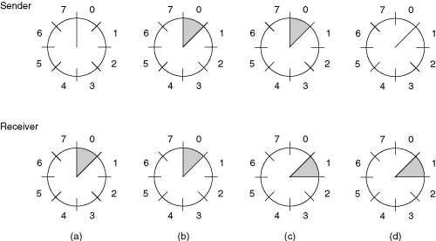
SLIDING WINDOW PROTOCOLS
The sender’s window and the receiver’s window need not have the same lower and upper limits or even have the same size.
In some protocols they are fixed in size, but in others they can grow or shrink over the
course of time as frames are sent and received.
A sliding window of size 1, with a 3-bit sequence number.
Initially.
After the first frame has been sent.
After the first frame has been received.
After the first acknowledgement has been received.
Computer Networks
Unit-2

Slide 68
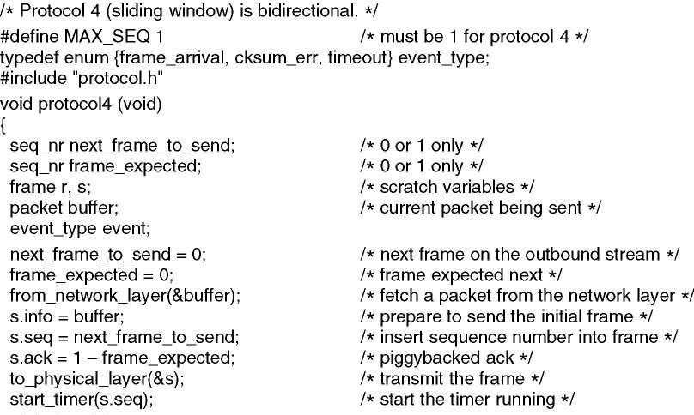
SLIDING WINDOW PROTOCOLS
PROTOCOL 4: A One-Bit Sliding Window Protocol
Computer Networks
Unit-2

Slide 69
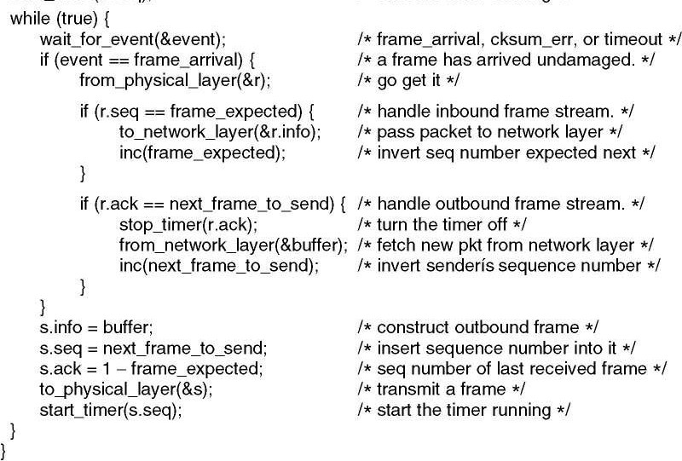
SLIDING WINDOW PROTOCOLS
PROTOCOL 4: A One-Bit Sliding Window Protocol
Computer Networks
Unit-2

Slide 70
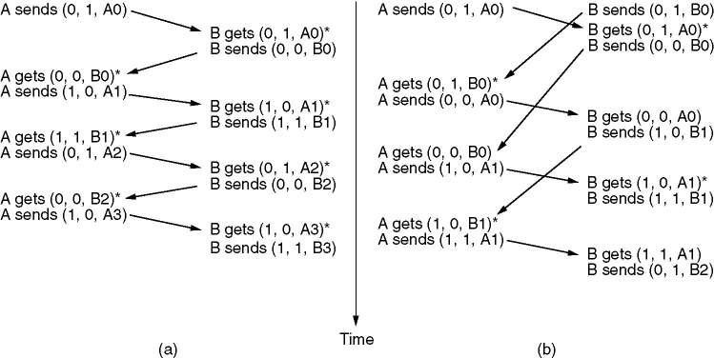
SLIDING WINDOW PROTOCOLS
PROTOCOL 4: A One-Bit Sliding Window Protocol
Two scenarios for protocol 4. (a) Normal case. (b) Abnormal case.
The notation is (seq, ack, packet number). An asterisk indicates where a network layer accepts a packet.
Computer Networks
Unit-2

Slide 71
SLIDING WINDOW PROTOCOLS
PROTOCOL 4: A One-Bit Sliding Window Protocol
Two scenarios for protocol 4. (a) Normal case. (b) Abnormal case.
The notation is (seq, ack, packet number). An asterisk indicates where a network layer accepts a packet.
Computer Networks
Unit-2

Slide 72
SLIDING WINDOW PROTOCOLS
Pipelining
Imagine in the above example, if the sender could send more frames without waiting for the ack for the first one, the channel could have been utilized more efficiently. This technique is called pipelining.
Imagine the scenario, when the sender always has something to send until the ack for the first frame arrives .. Best scenario, right?
Clearly this is not Stop-n Wait.
Computer Networks
Unit-2

Slide 73
SLIDING WINDOW PROTOCOLS
Pipelining
Let
Channel capacity is b bits/sec
Frame size l bits,
Round trip propagation time is R
The time required to transmit a single frame is l/b.
So, in stop n wait, the line is busy for l/b time and idle for R time, thus the
line utilization is
• = l/b divided by l/b + R = l/(l + bR).
If l < bR, the efficiency will be less than 50%.
Computer Networks
Unit-2

Slide 74
SLIDING WINDOW PROTOCOLS
Pipelining over noisy channels
What if one or more frames is errored.
Two options :
  Throw away all the subsequent frames and go back and start resending from the damaged frame. This corresponds to size 1 window in the receiver. - Go back N Protocol
  Buffer the subsequent frames and wait for the damaged frame to be resent, once that comes handover the frames in proper order to the NL-Selective Repeat Protocol
Computer Networks
Unit-2

Slide 75
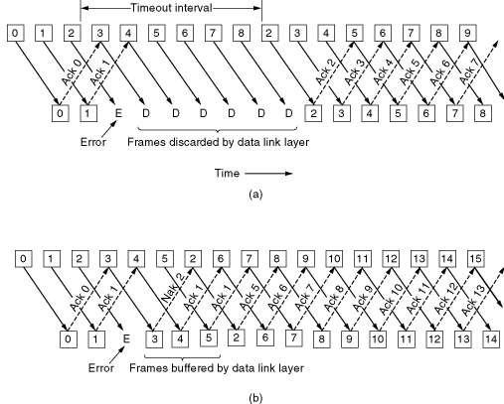
SLIDING WINDOW PROTOCOLS
PROTOCOL 5: A Protocol Using Go Back N
Pipelining and error recovery. Effect on an error when
Receiver’s window size is 1.
Receiver’s window size is large.
Computer Networks
Unit-2

Slide 76
SLIDING WINDOW PROTOCOLS
PROTOCOL 5: A Protocol Using Go Back N
Issues
For a maxseq = 7, Number of outstanding frames can only be 7 and not 8. To see why, let us consider what happens when 8 frames are allowed to be outstanding .. That is the scene is
Sender has sent out 8 frames
The piggybacked ack for frame 7 finally comes to the sender.
Now suppose the sender has 8 outstanding frames, 0…7
Now sender sends next frame 0, if it is lost, if B has a frame to send, B will send the
piggybacked ack for 7.
Computer Networks
Unit-2

Slide 77
SLIDING WINDOW PROTOCOLS
PROTOCOL 5: A Protocol Using Go Back N
Issues
Next, the sender sends the next frame 1 without waiting for the ack for 0, now suppose
this is also lost, again B has a frame to send,then B will again send ack for 7.
And so on .. Sender sends all the outstanding frames, 0…7
Suppose all of them are lost, the receiver will still send the ack of the last frame received
I.e. 7.
Now sender has no way of knowing, whether all the frames were lost or since it has received ack for 7..all the frames reached intact.
Computer Networks
Unit-2

Slide 78
SLIDING WINDOW PROTOCOLS
PROTOCOL 5: A Protocol Using Go Back N
Solution
The problem is solved by keeping at most 7 instead of 8 outstanding frames, say
  0-6 in the first batch, and
  7,0-5 in the second
If all the frames in the second batch are lost, sender may keep on receiving ack for frame 6 which is not in sender’s window and hence it will know that frames were lost.
Computer Networks
Unit-2

Slide 79
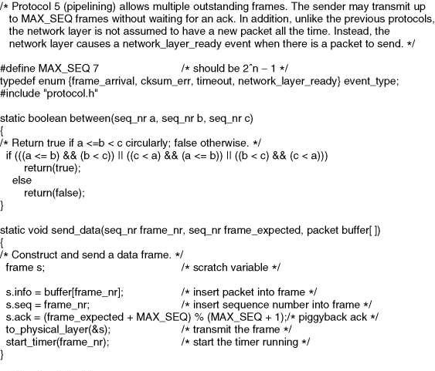
SLIDING WINDOW PROTOCOLS
PROTOCOL 5: A Protocol Using Go Back N
Computer Networks
Unit-2

Slide 80
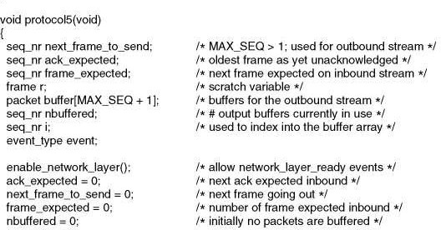
SLIDING WINDOW PROTOCOLS
PROTOCOL 5: A Protocol Using Go Back N
Computer Networks
Unit-2

Slide 81
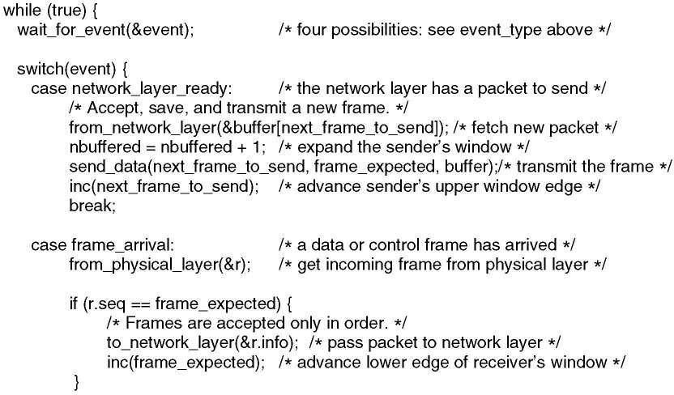
SLIDING WINDOW PROTOCOLS
PROTOCOL 5: A Protocol Using Go Back N
Computer Networks
Unit-2

Slide 82
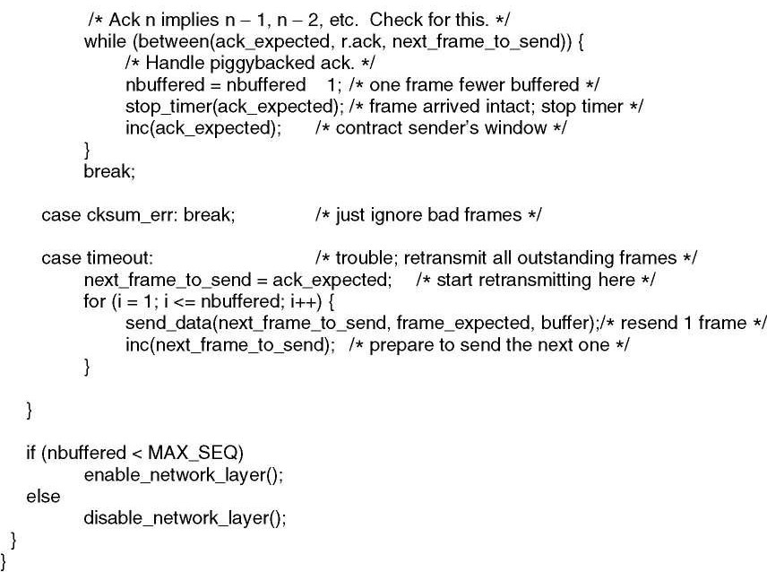
SLIDING WINDOW PROTOCOLS
PROTOCOL 5: A Protocol Using Go Back N
Computer Networks
Unit-2

Slide 83
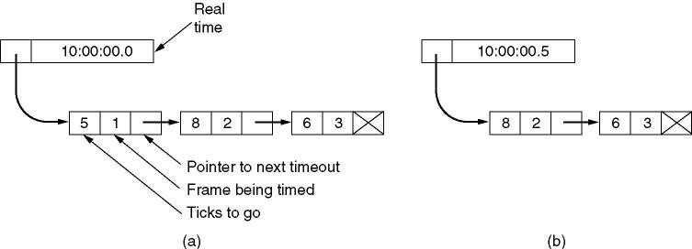
SLIDING WINDOW PROTOCOLS
PROTOCOL 5: A Protocol Using Go Back N
Simulation of multiple timers in software.
Computer Networks
Unit-2

Slide 84
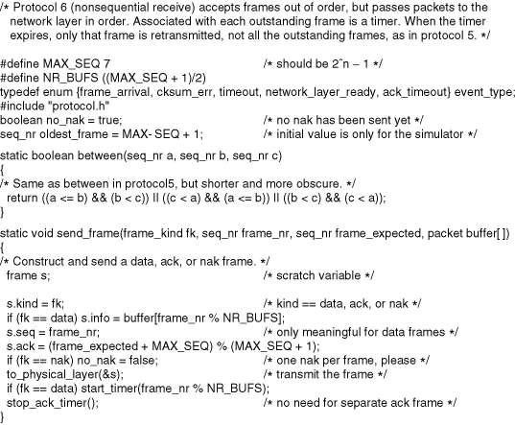
SLIDING WINDOW PROTOCOLS
PROTOCOL 6: A Sliding Window Protocol Using Selective Repeat
Computer Networks
Unit-2

Slide 85
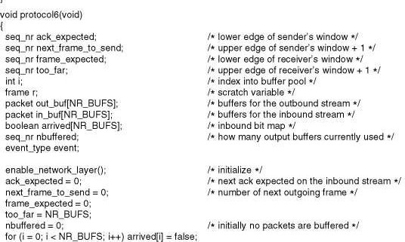
SLIDING WINDOW PROTOCOLS
PROTOCOL 6: A Sliding Window Protocol Using Selective Repeat
Computer Networks
Unit-2

Slide 86
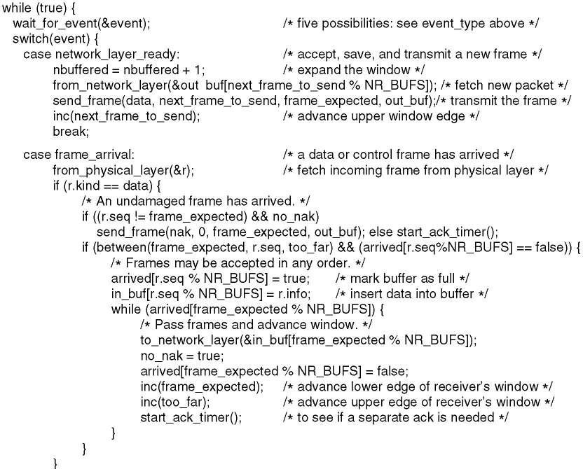
SLIDING WINDOW PROTOCOLS
PROTOCOL 6: A Sliding Window Protocol Using Selective Repeat
Computer Networks
Unit-2

Slide 87
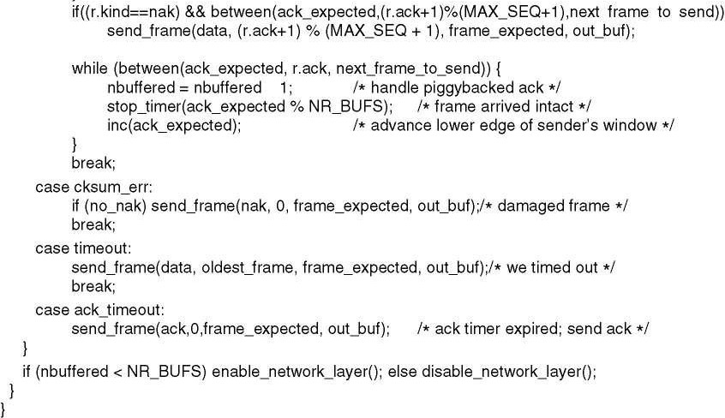
SLIDING WINDOW PROTOCOLS
PROTOCOL 6: A Sliding Window Protocol Using Selective Repeat
Computer Networks
Unit-2

Slide 88
SLIDING WINDOW PROTOCOLS
PROTOCOL 6: A Sliding Window Protocol Using Selective Repeat
Issues
7 frames 0-6 are sent,
Received, ack-ed, and window of the receiver advanced to 7,0-5
All ack lost
Sender times out and resends frame 0-6
At receiver, 0-5 accepted, buffered(since next frame it is expecting is 7) as new
frames and ack-ed (Ack 6) and 6 discarded and acked as a duplicate
Sender advances its window to 7,0-5
Sends packets 7,0-5
Computer Networks
Unit-2

Slide 89
SLIDING WINDOW PROTOCOLS
PROTOCOL 6: A Sliding Window Protocol Using Selective Repeat
Issues
7 is accepted and passed onto the NL
0 and others are rejected as duplicate and the previous buffered frames are passed
on to the NL - wrong packets!!!!
Order in which packets are sent:
P0…p6, p0…p6, p7, p0(new)…p5(new)
Order in which packets are handed over to NL of the receiver:
P0…p6,p7,p0…p5(duplicate) and rest are discarded including the new frames
Computer Networks
Unit-2

Slide 90
SLIDING WINDOW PROTOCOLS
PROTOCOL 6: A Sliding Window Protocol Using Selective Repeat
Solution
Keep the window size 4
That is half the range of permitted sequence numbers.
Computer Networks
Unit-2

Slide 91
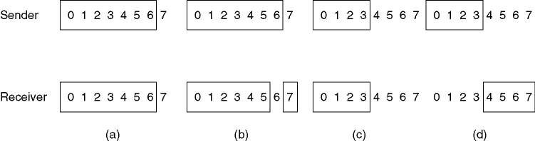
SLIDING WINDOW PROTOCOLS
PROTOCOL 6: A Sliding Window Protocol Using Selective Repeat
Initial situation with a window size seven.
After seven frames sent and received, but not acknowledged.
Initial situation with a window size of four.
After four frames sent and received, but not acknowledged.
Computer Networks
Unit-2

Slide 92
EXAMPLE DATA LINK PROTOCOLS
Many networks use one of the bit-oriented protocols – SDLC (Synchronous Data Link Control), HDLC (High-level Data Link Control), ADCCP (Advanced Data Communication Control Procedure), or LAPB (Link Access Procedure) – at data link level.
All of these protocols use flag bytes to delimit frames, and bit stuffing to prevent flag bytes
from occurring in the data.
HDLC – High-Level Data Link Control
  This is a classical bit-oriented protocol whose variants have been in use for decades in many applications.
The Data Link Layer in the Internet
  PPP is the data link protocol used to connect home computers to the Internet.
Computer Networks
Unit-2

Slide 93

EXAMPLE DATA LINK PROTOCOLS
High-Level Data Link Control
Frame format for bit-oriented protocols.
Uses bit stuffing for data transparency.
Address field is to identify one of the terminals;
Control field is used for sequence numbers, acknowledgements, and other purpose.
Data field may contain any information.
Checksum field is a cyclic redundancy code.
Computer Networks
Unit-2

Slide 94
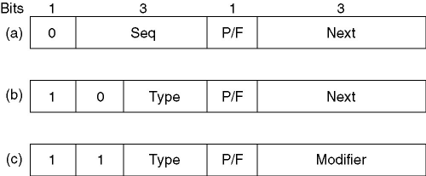
EXAMPLE DATA LINK PROTOCOLS
High-Level Data Link Control
Control field of
An information frame.
A supervisory frame.
An unnumbered frame.
Seq is the frame sequence number.
Next is piggybacked acknowledgement.
Type is for distinguishing various kinds of Supervisory frames.
P/F is Poll/Final.
Computer Networks
Unit-2

Slide 95
EXAMPLE DATA LINK PROTOCOLS
The Data Link Layer in the Internet
Internet consists of individual machines (hosts and routers) and the communication infrastructure that connects them.
LANs are widely used for interconnection, but most of the wide area infrastructure is built up
from point-to-point leased lines.
In this section we will examine the data link protocols used on point-to-point lines in the Internet.
In practice, point-to-point communication is primarily used in two situations:
All routers in subnet are communicated by point-to-point leased lines (or router-router leased line connection).
Many users have home connections to the Internet using modems and dial-up telephone lines (dial-up host-router connection).
For both router-router leased line connection and dial-up host-router connection, some point-to-point data link protocol is required on line for framing, error control, etc.
The one used in Internet is called PPP.
Computer Networks
Unit-2

Slide 96
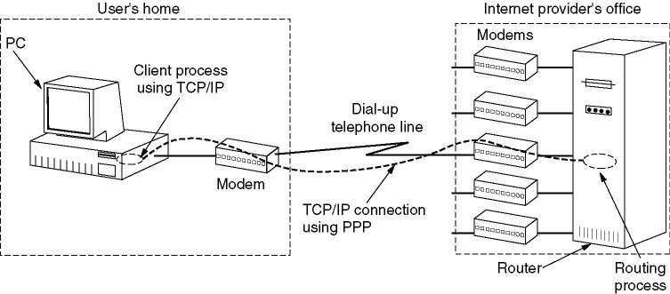
EXAMPLE DATA LINK PROTOCOLS
The Data Link Layer in the Internet
A home personal computer acting as an internet host.
Computer Networks
Unit-2

Slide 97
EXAMPLE DATA LINK PROTOCOLS
The Data Link Layer in the Internet Point to Point Protocol
PPP handles error detection, supports multiple protocols, allows IP addresses to be negotiated at connection time, permits authentication, and has many other features.
PPP provides three features:
  A framing method that unambiguously delineates the end of one frame and the start of the next one. The frame format also handles error detection.
  LCP – Link Control Protocol for bringing lines up, testing them, negotiating options, and
bringing them down again gracefully when they are no longer needed.
  NCP – Network Control Protocol . A way to negotiate network-layer options in a way that is independent of the network layer protocol to be used.
Computer Networks
Unit-2

Slide 98

EXAMPLE DATA LINK PROTOCOLS
The Data Link Layer in the Internet Point to Point Protocol
The PPP full frame format for unnumbered mode operation.
Address is always set to the binary value 1111111 to indicate that all stations are to accept the frame.
Control is always set to the 00000011 which indicates an unnumbered frame.
Protocol tells what kind of packet is in the Payload field.
Computer Networks
Unit-2

Slide 99
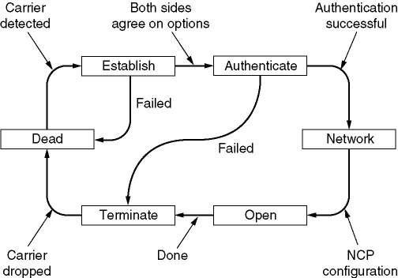
EXAMPLE DATA LINK PROTOCOLS
The Data Link Layer in the Internet Point to Point Protocol
A simplified phase diagram for bring a line up and down.
Computer Networks
Unit-2

Slide 100
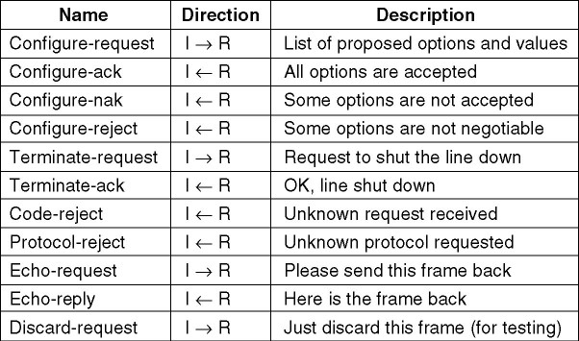
EXAMPLE DATA LINK PROTOCOLS
The Data Link Layer in the Internet Point to Point Protocol
The LCP (Link Control Protocol) frame types.
I –INITIATOR R - RESPONDER
Computer Networks
Unit-2

Slide 101
MEDIUM ACCESS SUB LAYER
Networks can be divided into two categories:
  Those using point-to-point connections and
  Those using broadcast channels.
In any broadcast network, the key issue is how to determine who gets to use the channel
when there is competition for it.
To make this point clearer, consider a conference call in which six people, on six different telephones, are all connected together so that each one can hear and talk to all the others.
It is very likely that when one of them stops speaking, two or more will start talking at once, leading to chaos.
In a face-to-face meeting, chaos is avoided by external means, for example, at a meeting,
people raise their hands to request permission to speak.
Computer Networks
Unit-2

Slide 102
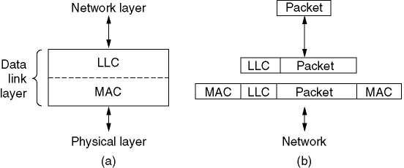
MEDIUM ACCESS SUB LAYER
When only a single channel is available, determining who should go next is much harder.
Many protocols for solving the problem are known and form the contents of this chapter.
In the literature, broadcast channels are sometimes referred to as multi-access channels
or random access channels.
The protocols used to determine who goes next on a multi-access channel belong to a sublayer of the data link layer called the MAC (Medium Access Control) sublayer.
Technically, the MAC sublayer is the bottom part of the data link layer.
Computer Networks
Unit-2

Slide 103
MEDIUM ACCESS SUB LAYER
The MAC sublayer is especially important in LANs, nearly all of which use a multiaccess channel as the basis of their communication.
WANs, in contrast, use point-to-point links, except for satellite networks.
Because multi-access channels and LANs are so closely related, in this chapter we will discuss LANs in general, as well as satellite and some other broadcast networks
Computer Networks
Unit-2

Slide 104
THE CHANNEL ALLOCATION PROBLEM
The central theme of this chapter is how to allocate a single broadcast channel among competing users.
We will first look at static and dynamic schemes in general. Then we will examine a number of specific algorithms.
Computer Networks
Unit-2

Slide 105
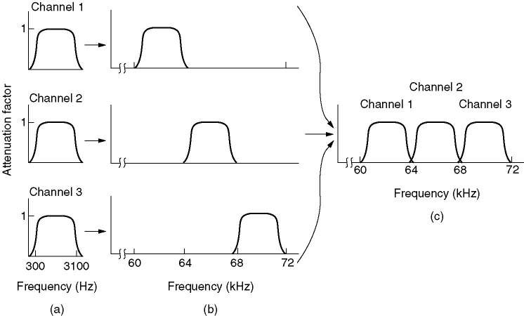
THE CHANNEL ALLOCATION PROBLEM
Static Channel Allocation in LANs and MANs
The traditional way of allocation a single channel, such as a telephone trunk, among multiple competing users is Frequency Division Multiplexing (FDM).
If there are N users, the bandwidth is divided into N equal sized portions, each user being assigned one portion.
(a) The original bandwidths.
(b) The bandwidths raised in frequency.
(b) The multiplexed channel.
Computer Networks
Unit-2

Slide 106
THE CHANNEL ALLOCATION PROBLEM
Static Channel Allocation in LANs and MANs
Since each user has a private frequency band, there is no interference between users
When there is only a small and fixed number of users, each of which has a heavy
(buffered) load of traffic (e.g., carriers’ switching offices), FDM is a simple and efficient allocation mechanism.
However, when the number of senders is large and continuously varying, or the traffic is
bursty, FDM presents some problems.
If the spectrum is cut up into N regions, and fewer than N users are currently interested in communicating, a large piece of valuable spectrum will be wasted.
Computer Networks
Unit-2

Slide 107
THE CHANNEL ALLOCATION PROBLEM
Static Channel Allocation in LANs and MANs
If more than N users want to communicate, some of them will be denied permission, for lack of bandwidth, even if some of the users who have been assigned a frequency band
hardly ever transmit or receive anything.
However, even assuming that the number of users could somehow be held constant at N, dividing the single available channel into static subchannels is inherently inefficient.
The basic problem is that when some users are quiescent, their bandwidth is simply lost.
They are not using it, and no one else is allowed to use it either.
Furthermore, in most computer systems, data traffic is extremely bursty (peak traffic to mean traffic ratios of 1000:1 are common).
Consequently, most of the channels will be idle most of the time.
Computer Networks
Unit-2

Slide 108
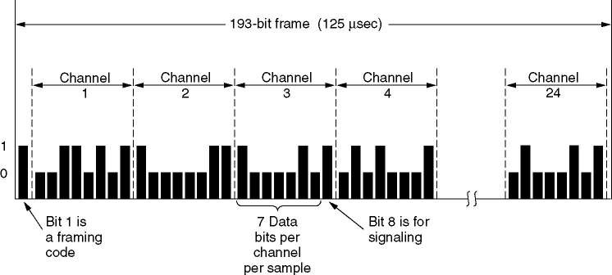
THE CHANNEL ALLOCATION PROBLEM
Static Channel Allocation in LANs and MANs
Precisely the same arguments that apply to FDM also apply to time division multiplexing (TDM).
Each user is statically allocated every Nth time slot.
If a user does not use the allocated slot, it just lies fallow.
Time Division Multiplexing
The T1 carrier (1.544 Mbps).
Computer Networks
Unit-2

Slide 109
THE CHANNEL ALLOCATION PROBLEM
Static Channel Allocation in LANs and MANs
Since none of the traditional static channel allocation methods work well with bursty traffic, we will now explore dynamic methods.
Computer Networks
Unit-2

Slide 110
THE CHANNEL ALLOCATION PROBLEM
Dynamic Channel Allocation in LANs and MANs
Before we get into the first of the many channel allocation methods to be discussed in this chapter, it is worthwhile carefully formulating the allocation problem.
Underlying all the work done in this area are five key assumptions, described below.
  Station Model.
    The model consists of N independent stations (e.g., computers, telephones, or personnel communicators), each with a program or user that generates frames for transmissions. Stations are sometimes called terminals.
    Once a frame has been generated, the station is blocked and does nothing until the frame has been successfully transmitted.
Computer Networks
Unit-2

Slide 111
THE CHANNEL ALLOCATION PROBLEM
Dynamic Channel Allocation in LANs and MANs
Single Channel Assumption.
  A single channel is available for all communication. All stations can transmit on it and all can receive from it.
Collision Assumption.
  If two frames are transmitted simultaneously, they overlap in time and the resulting signal is garbled. This event is called a collision. All stations can detect collisions.
Computer Networks
Unit-2

Slide 112
THE CHANNEL ALLOCATION PROBLEM
Dynamic Channel Allocation in LANs and MANs 4.(a) Continuous Time.
Frame transmission can begin at any instant. There is no master clock dividing time into discrete intervals.
4.(b) Slotted Time.
Time is divided into discrete intervals (slots). Frame transmissions always begin at the start of a slot. A slot may contain 0, 1, or more frames, corresponding to an idle slot, a successful transmission, or a collision, respectively.
Computer Networks
Unit-2

Slide 113
THE CHANNEL ALLOCATION PROBLEM
Dynamic Channel Allocation in LANs and MANs 5.(a) Carrier Sense.
Stations can tell if the channel is in use before trying to use it. If the channel is sensed as busy, no station will attempt to use it until it goes idle.
5.(b) No Carrier Sense.
Stations cannot sense the channel before trying to use it. They go ahead and
transmit. Only later can determine whether the transmission was successful.
Computer Networks
Unit-2

Slide 114
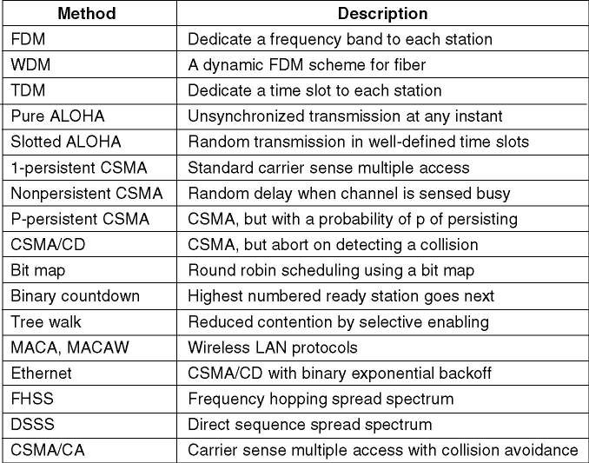
MULTIPLE ACCESS PROTOCOLS
Many Algorithms for Allocating a Multiple Access Channel are Known.
Channel allocation methods and systems for a common channel.
Computer Networks
Unit-2

Slide 115
THE CHANNEL ALLOCATION PROBLEM
ALOHA
Although Abramson’s work, called ALOHA system, used ground-based radio broadcasting, the basic idea is applicable to any system in which uncoordinated users are competing for
the use of a single shared channel.
We will discuss two versions of ALOHA here: pure (1970) and slotted (1972). They differ with respect to whether time is divided into discrete slots into which all frames must fit. Pure ALOHA does not require global time synchronization; slotted ALOHA does.
Computer Networks
Unit-2

Slide 116
THE CHANNEL ALLOCATION PROBLEM
ALOHA
Pure ALOHA
The basic idea of an ALOHA system is simple: let users transmit whenever they have data to be sent.
There will be collisions, of course, and the colliding frames will be damaged.
However, due to the feedback property of broadcasting, a sender can always find out
whether its frame was destroyed by listening to the channel, the same way other users do.
If listening while transmitting is not possible for some reason, acknowledgements are needed.
If the frame was destroyed, the sender just waits a random amount of time and sends it
again.
Systems in which multiple users share a common channel in a way that can lead to conflicts are widely known as contention systems.
Computer Networks
Unit-2

Slide 117
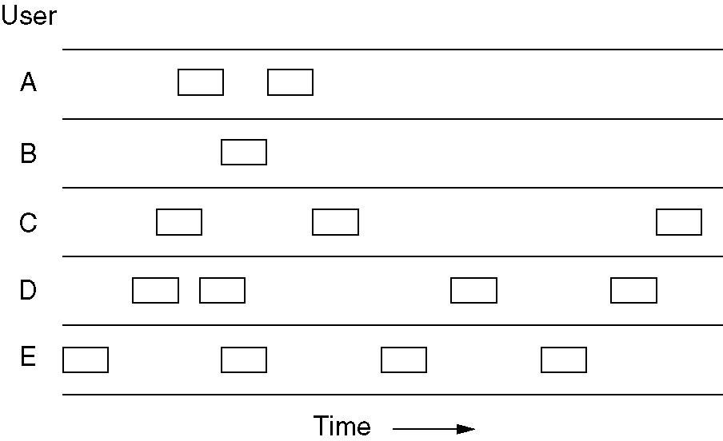
THE CHANNEL ALLOCATION PROBLEM
ALOHA
Pure ALOHA
In pure ALOHA, frames are transmitted at completely arbitrary times.
Computer Networks
Unit-2

Slide 118
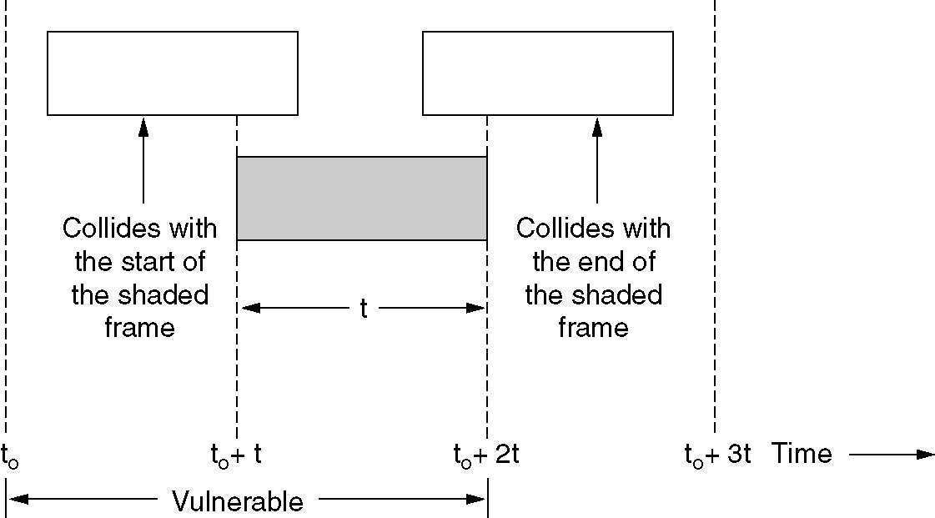
THE CHANNEL ALLOCATION PROBLEM
ALOHA
Pure ALOHA
Vulnerable period for the shaded frame.
Computer Networks
Unit-2

Slide 119
THE CHANNEL ALLOCATION PROBLEM
ALOHA
Pure ALOHA
With pure ALOHA the best channel utilization that can be achieved is S=Ge^{-2G}
for pure ALOHA
G=0.5
and
S=1/2e or 18 percent
Computer Networks
Unit-2

Slide 120
THE CHANNEL ALLOCATION PROBLEM
ALOHA
Slotted ALOHA
In 1972, Roberts published a method for doubling the capacity of an ALOHA system. His proposal was to divide time into discrete intervals, each interval corresponding to one frame.
This approach requires the users to agree on slot boundaries. One way to achieve synchronization would be to have one special station emit a pip at the start of each interval, like a clock.
In Roberts’ method, which has come to be known as slotted ALOHA, in contrast to Abramson’s pure ALOHA, a computer is not permitted to send whenever a carriage return is typed. Instead, it is required to wait for the beginning of the next slot
Thus, the continuous pure ALOHA is turned into a discrete one.
Computer Networks
Unit-2

Slide 121
THE CHANNEL ALLOCATION PROBLEM
ALOHA
Slotted ALOHA
With Slotted ALOHA the best channel utilization that can be achieved is S=Ge^{-G}
for slotted ALOHA
G=1
and
S=1/e or 36 percent
Computer Networks
Unit-2

Slide 122
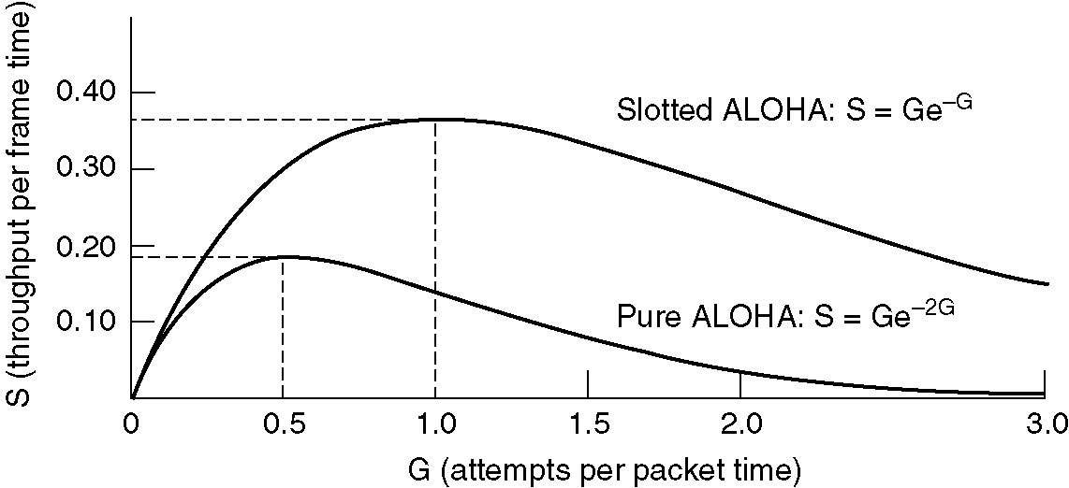
THE CHANNEL ALLOCATION PROBLEM
ALOHA
Pure and Slotted ALOHA
Throughput versus offered traffic for ALOHA systems.
Computer Networks
Unit-2

Slide 123
THE CHANNEL ALLOCATION PROBLEM
Carrier Sense Multiple Access Protocols
With slotted ALOHA the best channel utilization that can be achieved is 1/e. This is hardly surprising, since with stations transmitting at will, without paying attention to what the other station are doing, there are bound to be many collisions.
In local area networks, however, it is possible for station to detect what other station are doing, and adapt their behavior accordingly. This networks can achieve a much better utilization than 1/e.
In this section we will discuss some protocols for improving performance.
Protocols in which stations listen for a carrier (i.e., a transmission) and act accordingly are called carrier sense protocols.
Computer Networks
Unit-2

Slide 124
THE CHANNEL ALLOCATION PROBLEM
Carrier Sense Multiple Access Protocols
A number of them have been proposed.
  1-persistent CSMA (Carrier Sense Multiple Access)
  nonpersistent CSMA
  p-persistent CSMA
  CSMA with Collision Detection (CSMA/CD)
Computer Networks
Unit-2

Slide 125
THE CHANNEL ALLOCATION PROBLEM
Carrier Sense Multiple Access Protocols
persistent CSMA
  When a station has data to send, it first listens to the channel to see if anyone else is transmitting at that moment.
  If the channel is busy, the station waits until it becomes idle. When the station detects an idle channel, it transmits a frame.
  If a collision occurs, the station waits a random amount of time and starts all over again.
  The protocol is called 1-persistent because the station transmits with a probability of 1 when it finds the channel idle.
Computer Networks
Unit-2

Slide 126
THE CHANNEL ALLOCATION PROBLEM
Carrier Sense Multiple Access Protocols
Nonpersistent CSMA
Before sending, a station senses the channel. If no one else is sending, the station begins doing so itself.
However, if the channel is already in use, the station does not continually sense it for the purpose of seizing it immediately upon detecting the end of the previous
transmission.
Instead, it waits a random period of time and then repeats the algorithm.
Consequently, this algorithm leads to better channel utilization but longer delays than 1-persistent CSMA.
Computer Networks
Unit-2

Slide 127
THE CHANNEL ALLOCATION PROBLEM
Carrier Sense Multiple Access Protocols
p-persistent CSMA
It applies to slotted channel and works as follows.
When a station becomes ready to send, it sense the channel. If it is idle, it transmits with a probability p.
With a probability q=1-p, it defers until the next slot.
If that slot is also idle, it either transmits or defers again, with probabilities p and q.
This process is repeated until either the frame has been transmitted or another station has begun transmitting.
Computer Networks
Unit-2

Slide 128
THE CHANNEL ALLOCATION PROBLEM
Carrier Sense Multiple Access Protocols
CSMA with Collision Detection
Another improvement over ALOHA is for station to abort their transmissions as soon as they detect a collision.
In other words, if two stations sense the channel to be idle and begin transmitting simultaneously, they will both detect the collision almost immediately.
Rather than finish transmitting their frames, which are irretrievably garbled anyway, they should abruptly stop transmitting as soon as the collision is detected.
Quickly terminating damaged frames saves time and bandwidth.
This protocol is widely used on LANs in the MAC sublayer.
Computer Networks
Unit-2

Slide 129
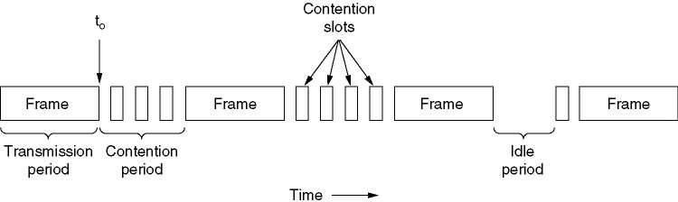
THE CHANNEL ALLOCATION PROBLEM
Carrier Sense Multiple Access Protocols
CSMA with Collision Detection
CSMA/CD can be in one of three states: contention, transmission, or idle.
Computer Networks
Unit-2

Slide 130
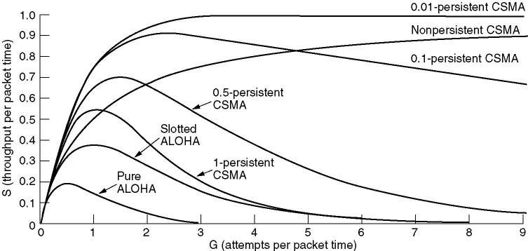
THE CHANNEL ALLOCATION PROBLEM
Carrier Sense Multiple Access Protocols
CSMA Protocols Performance
Comparison of the channel utilization versus load for various random access protocols.
Computer Networks
Unit-2

Slide 131
COLLISION-FREE PROTOCOLS
Although collisions do not occur with CSMA/CD once a station has unambiguously captured the channel, they can still occur during the contention period.
These collisions adversely affect the system performance, especially when the cable is long and the frames are short. And CSMA/CD is not universally applicable.
In this section, we will examine two protocols that resolve the contention for channel without any collisions at all, not even during the contention period.
  a bit-map protocol
  binary countdown
Computer Networks
Unit-2

Slide 132
COLLISION-FREE PROTOCOLS
Assumptions for these two protocols:
  there are exactly n stations, each with a unique address from 0 to n-1 “wired”
into it.
  propagation delay is negligible
Computer Networks
Unit-2

Slide 133
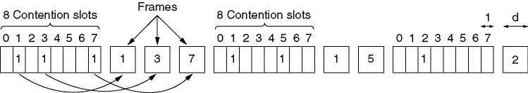
COLLISION-FREE PROTOCOLS
Basic Bit-Map Protocol:
In this protocol, each contention period consists of exactly n slots.
If station 0 has a frame to send, it transmits a 1 bit during the zeroth slot.
No other station is allowed to transmit during this slot.
In general, station j may announce that it has a frame to send by inserting a 1 bit into slot j.
The basic bit-map protocol.
Computer Networks
Unit-2

Slide 134
COLLISION-FREE PROTOCOLS
Binary Countdown:
A problem with the basic bit-map protocol is that the overhead is 1 bit per
station, so it does not scale well to networks with thousands of stations.
We can do better than that by using binary station addresses.
A station wanting to use the channel now broadcasts its address as a binary bit string, starting with the high-order bit.
All addresses are assumed to be the same length.
The bits in each address position from different stations are Boolean ORed together.
Computer Networks
Unit-2

Slide 135
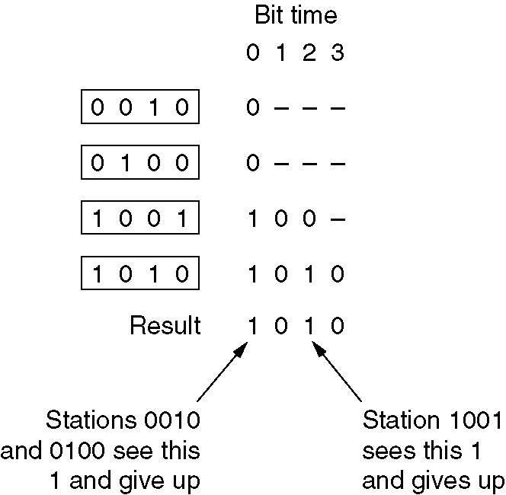
COLLISION-FREE PROTOCOLS
Binary Countdown:
The binary countdown protocol. A dash indicates silence.
Computer Networks
Unit-2

Slide 136
ETHERNET
Both the INTERNET and ATM were designed for Wide Area Networking.
However, many companies universities, and other organizations have large
numbers of computers that must be connected.
This need gave rise to the Local Area Network.
In this section we will say a little bit about the most popular LAN, ETHERNET
Computer Networks
Unit-2

Slide 137
ETHERNET
A practical example, dealing (mostly) with MAC: Ethernet
  Standardized by IEEE as standard 802.3
  Part of the 802 family of standards dealing with MAC protocols
  Also contains PHY and DLC specifications
Issues
  Cabling
  Physical layer
  MAC sublayer
  Switched Ethernet
  Fast & gigabit Ethernet
Computer Networks
Unit-2

Slide 138
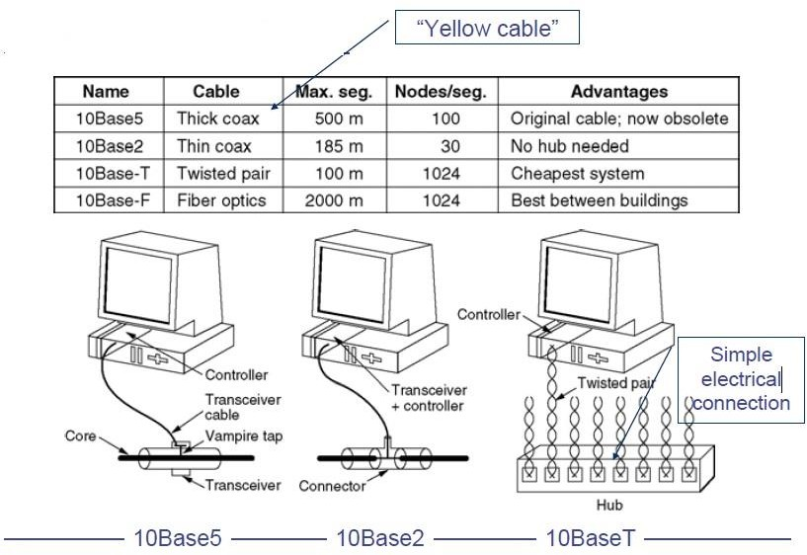
ETHERNET
Cabling
Computer Networks
Unit-2

Slide 139
ETHERNET
Ethernet Physical Layer
Details depend on medium
Common: Manchester encoding
  At +/- 0.85 V (typically) to ensure DC freeness
With option for signal violations
  Used to demarcate frames
Computer Networks
Unit-2

Slide 140
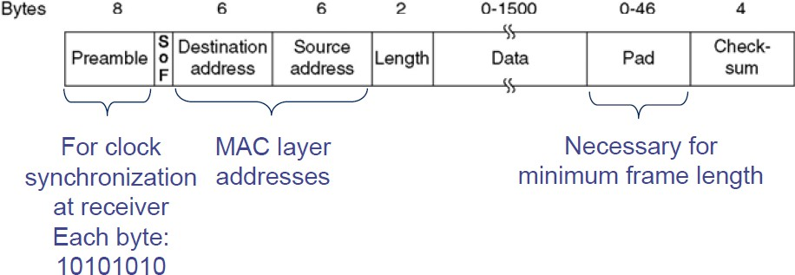
ETHERNET
Ethernet MAC Sub Layer
Essentially: CSMA/CD with binary exponential backoff
Frame format:
Computer Networks
Unit-2

Slide 141

ETHERNET
Switched Ethernet
With conventional 10Base5/10Base2 Ethernet, all stations attached to a single cable form a collision domain
  Packets from all these stations might potentially collide
  Big collision domains stress the CSMA/CD mechanism, reducing performance
How to reduce collision domains but still maintain connectivity of local stations?
  Use smaller collision domains!
  To ensure connectivity, put a switch in
Computer Networks
Unit-2

Slide 142

ETHERNET
An Ethernet Switch
Unlike a hub, not a simple electrical connection for a starwired topology
How to exchange packets between different collision domains?
  Switch contains buffers to intermediately store incoming packets before forwarding them towards their destination
  Different buffer structures possible: one per incoming link, one per group of links,…
  Cost issue, mainly
Computer Networks
Unit-2

Slide 143
ETHERNET
Fast Ethernet
“Normal” (even switched) Ethernet “only” achieves 10 MBit/s
1992: Build a faster Ethernet!
  Goals: Backward compatible, stick with the old protocol to avoid hidden traps, get job done quickly
  Result: 802.3u – aka “Fast Ethernet”
Fast Ethernet
  Keep everything the same (frame format, protocol rules)
  Reduce bit time from 100 ns to 10 ns
  Consequences for maximum length of a wiring segment, minimum packet sizes?
(Recall unavoidable collisions in CSMA!)
Computer Networks
Unit-2

Slide 144

ETHERNET
Fast Ethernet - Cabling
Standard category 3 twisted pairs (telephony cables) cannot support 200 MBaud over 100 m cable length
  Solution: use 2 pairs of wires in this case, reduce baud rate
Also, Fast Ethernet/cat 5 cabling does not use Manchester, but 4B/5B
Computer Networks
Unit-2

Slide 145

ETHERNET
Gigabit Ethernet
Ok: can we go another factor of 10 faster?
  1995 – gigabit Ethernet
  Goal: again, keep basic scheme as it is
Works, but price to pay: No more multi-drop configurations as in classic Ethernet
  In gigabit Ethernet, each wire has exactly two machines attached to it
    Terminal and/or switch/hub
Computer Networks
Unit-2

Slide 146

ETHERNET
Gigabit Ethernet
With a switch
  No shared collision domains → no collision → no need for CSMA/CD
  Allows full-duplex operation of each link
With a hub
  Collisions, half duplex, CSMA/CD
  Maximum cable distance is reduced to 25 m
  Actually: not very sensible combination from a cost/performance perspective
Cabling
Computer Networks
Unit-2

Slide 147
ETHERNET
And how does traffic on an Ethernet look like?
How many packets are there, per time unit, transmitted over a typical Ethernet?
Assumptions:
  Many sources connected to a single Ethernet
  Sources independently generate traffic (=try to transmit a packet)
Intuition:
  Average number of transmitted packets might be bursty over short time windows
  The longer the considered time window, the smoother the number of transmissions should become, right?
Computer Networks
Unit-2

